Slide 1

Cryptovisor: A Cryptocurrency Advisor Tool

Slide 2
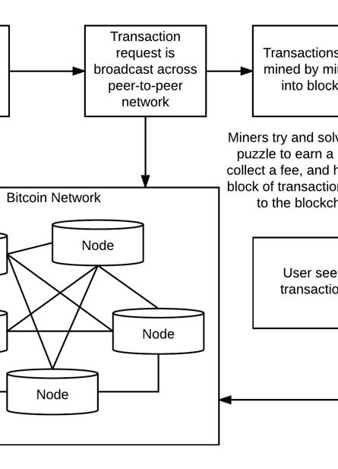

Blockchain
First conceptual work on secured chain of blocks in 1991 by Stuart Haber and W. Scott Stornetta
Decentralized
Distributed
Public Ledger

Slide 3

Cryptocurrencies
First blockchain work conceptualized in 2008 by person (or group) Satoshi Nakamoto
Public Ledger Records Transactions
Blocks Hold Valid Transactions
Validated Through Peer-to-Peer Network

Slide 4
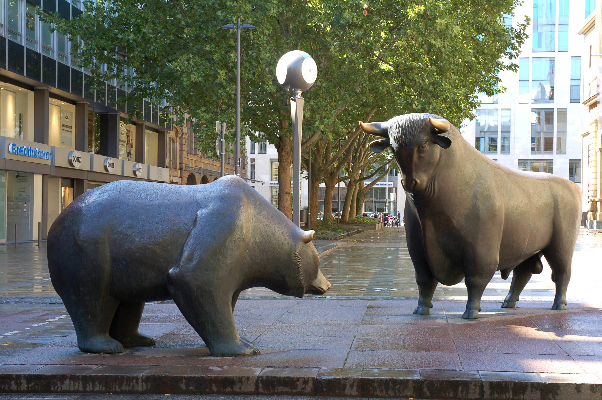
Cryptocurrency Investing
Volatility makes forecasting difficult
Not government backed
Investor hype can cause large swings
Large sell-offs not regulated
No Fundamental Indicators

Slide 5
Crypto tools, what exists
Many sources of information exist.
There not a tool to aggregate this information.
Analysis is up to the investor, whether new to the investment world or not.

Slide 6
What needs to improve on these tools
Analysis to make investment descisions.
This market is unique due to the investment vehicle itself.

Slide 7
Cryptovisor: A Cryptocurrency Advisor Tool
A unique recommendation system.
Can make a recommendation based on history through machine learned patterns.

Slide 8
Why does this tool matter
Investors are going blind into a volatile and new market.
This tool is necessary to make intelligent descisions.

Slide 9
What other comparible tools are there
None
Current investment site give you past trends but do not provide the deep learning this tool provides.

Slide 10
What is the impetus for a new tool?
There are no other tools in this arena, it is in a class by itself.
Investing in cryptocurrency is now made available o the general public and not something only a techie would understand.

Slide 11
How does it Work: The Labeler
The Labeler reads in cryptocurrency exchange data and up samples or down samples it appropriately and labels data as a buy, sell, or hold signal based on algorithm. A grid of parameters are used to tune the algorithm for best Sharpe Ratio.

Slide 12
How does it Work: The Modeler
The Modeler reads in labeled data, cleans it and separates out features from the labeled target. A stochastic gradient boost classifier, XGBoost, is trained with a stratified 5-fold cross validation to determine accuracy. Feature are pruned to yield simples model without sacrificing accuracy for maximum usability. Simplified model is used as recommender

Slide 13
Why does this tool outperform
Uses classical machine learning to understand the envrinoment of Bitcoin

Slide 14
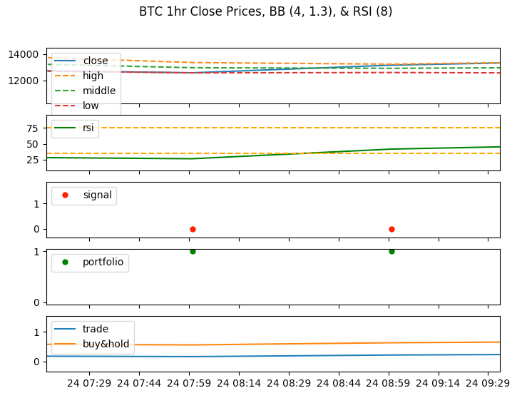
results # 1
Output charts from labeler component.
close price with BB in the top row
RSI with buy and sell targets in the second row
buy and sell signal points in the third row
portfolio strategy in fourth row
strategy results in fifth row
aaaa
Cryptovisor - Results
14

Slide 15
Cryptovisor – Results
2,000 trading signals over a three-month period
The labeler component identified:
1.31% as sell signals
2.62% as buy signals
Trading strategy for the bear market beat the buy and hold strategy in an annualized return by 1.173 and Sharpe Ratio by 0.43

Slide 16
Cryptovisor – Results
Cryptovisor is 95.5% accurate with a standard deviation of 0.54% and outperformed buy and hold in a bear market.
Summary | Bull Trade | Bull B&H | Bear Trade | Bear B& H | Both Trade | Both B&H
Return | 13.66 | 16.78 | 1.18 | 0.007 | 5.17 | 5.96
Sharpe Ratio(Rf=0%) | 3.67 | 3.54 | 1.26 | 0.83 | 2.16 | 2.17

Slide 17
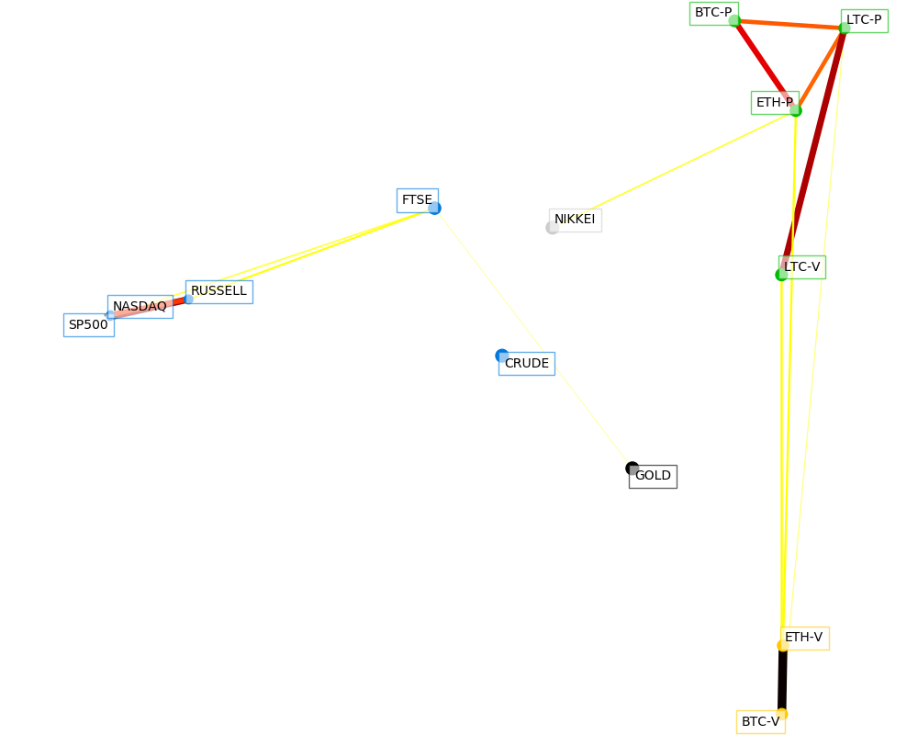
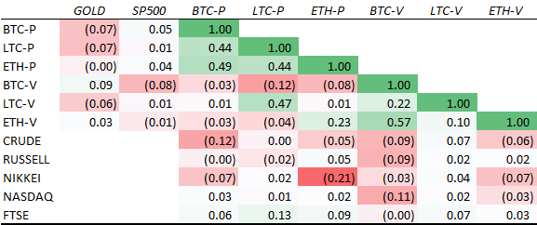
Correlation with other Assets
Cyrptovisor is needed because BTC is not like other assets

Slide 18
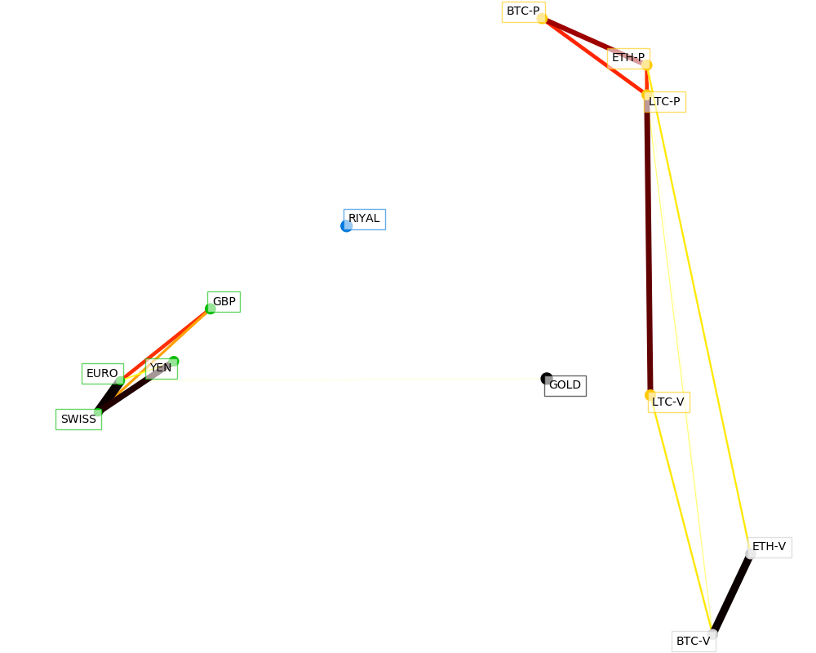
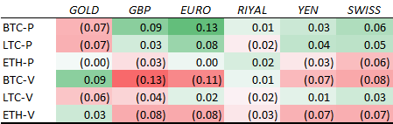
Bitcoin vs Fiat
Cyrptovisor is needed because BTC is not like other Fiat

Slide 19
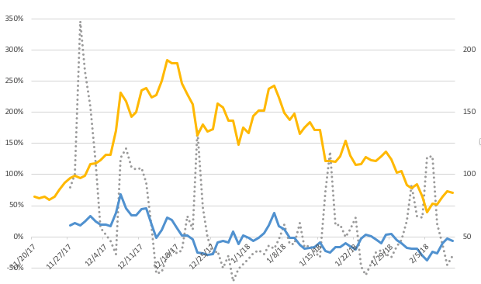
Utilizing Sentiment Analysis this tool can be further enhanced

Slide 20
Cryptovisor Performance

Slide 21
Conclusion
crypto-currency market is volatile and in its infancy
environment is risky for individual investors
current tools these investors have to employ to help them make crypto-currency investment decisions is limited
Cryptovisor, that is 95.5% accurate in determining the buy, sell or hold position for Bitcoin

